Slide 1
WP1 – Management
4th November, 2019
Author: Jordi Bodera Sempere

Slide 2

WP1 - MANAGEMENT Table of Contents
PaNOSC today
PaNOSC overall planning
Internal Financial report
KPIs
Collaborations with ExPaNDS and other cluster projects
PaNOSC in 2020

Slide 3
WP1 - MANAGEMENT PaNOSC Today
Executing since 01/12/2018
All deliverables and milestones due, successfully submitted
6 deliverables, 6 milestones and POPD requirement submitted
Internal milestones created to facilitate follow-up of progress
All seven partners engaged
ESRF, ILL, XFEL, ESS, ELI and CERIC attending bi-weekly meetings
BUT NOT ALL WP LEADERS ATTENDING
EGI attending regular WP6 meetings
Géant is not a partner but is contributing actively
Links stablished with ExPaNDS
Project underspending

Slide 4
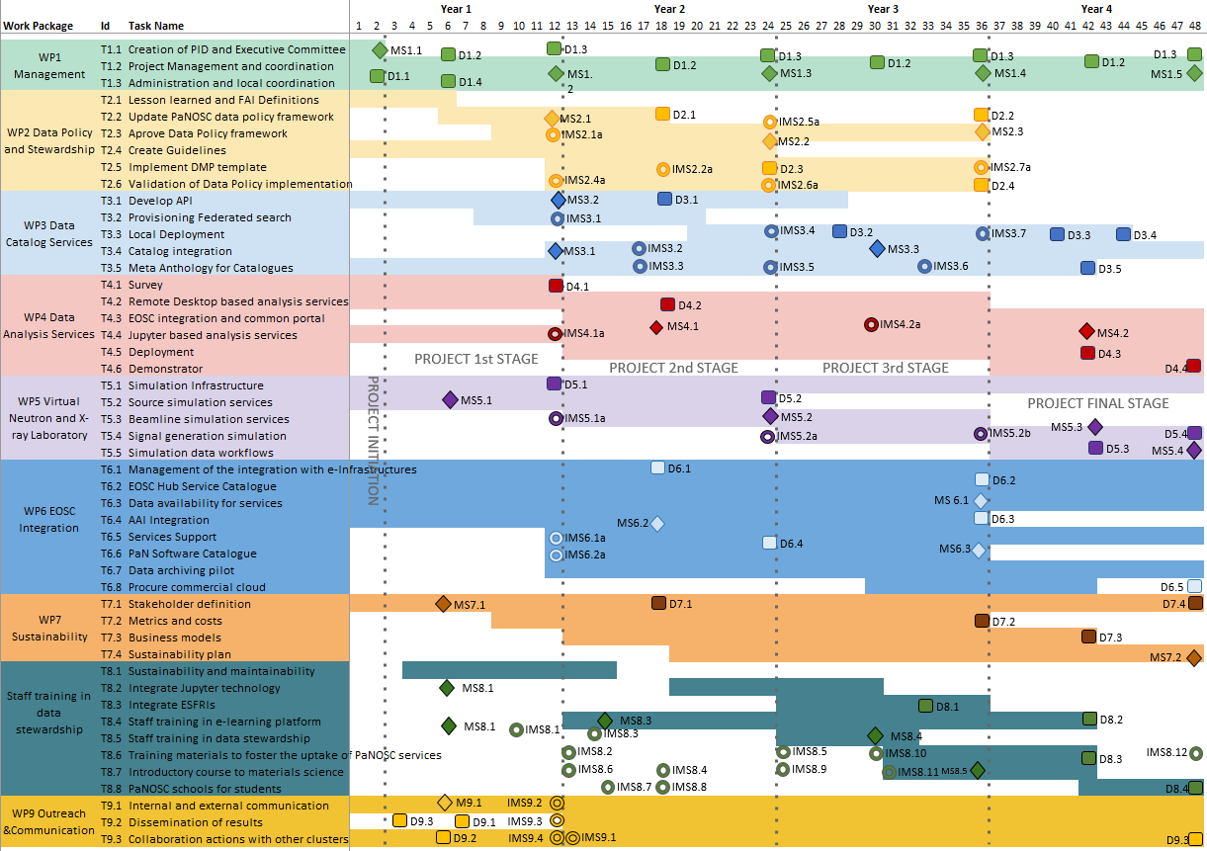
WP1 - MANAGEMENT PaNOSC Overall Planning
Due in 2020:
10 deliverables
6 milestones
Target spent by M24:
4.6M€
Notes:
D3.1 API Definition; D4.2 Prototypes of Remote Desktop and Jupyter Service; D6.1 EGI data-hub integration with facilities’ data repositories; MS8.3 pan-learning.org up and running

Slide 5
WP1 - MANAGEMENT Internal Financial Report (1 of 3)
Report covers first 9 months of project execution
Just for our consumption, not to be submitted to the EC
Comparing actual vs. forecast expenditure levels
Looking at 3 expenditure categories
Person/months, travel and subsistence & other expenses
Questionnaires shared with WP leaders and partners
Shared with EB and PMC

Slide 6
WP1 - MANAGEMENT Internal Financial Report (2 of 3)
Type | Forecast | Actual | Percentage of forecast
Staff | 1205.1 K€ | 707.2 K€ | 59%
Travel | 90.9 K€ | 43.2 K€ | 47%
Other | 61.8 K€ | 31.9 K€ | 52%
Total | 1357.9 K€ | 782.2 K€ | 58%
 | Actual PMs | Forecast PMs | % | Actual % of total | Forecasted Percentage of total
WP1 | 6.1 | 13.6 | 45% | 5% | 7%
WP2 | 4.3 | 16.4 | 26% | 4% | 9%
WP3 | 33.5 | 39.8 | 84% | 29% | 21%
WP4 | 34.6 | 46.5 | 74% | 30% | 25%
WP5 | 15.4 | 21.8 | 71% | 14% | 12%
WP6* | 12.8 | 27.6 | 46% | 11% | 15%
WP7 | 1.5 | 1.7 | 85% | 1% | 1%
WP8 | 1.3 | 9.0 | 14% | 1% | 5%
WP9 | 4.3 | 9.8 | 44% | 4% | 5%
TOTAL | 113.67 | 186.1 | 61% | 100% | 100%
 | Actual PMs | Forecasted PMs | Actual Expenditure | Forecasted Expenditure | % weight in PMs | Forecasted weight in PMs | % expenditure weight | Forecasted % weight
ESRF | 18.7 | 33.7 | 141.0 | 273.4 | 16% | 18% | 18% | 20%
ILL | 19.8 | 25.1 | 186.4 | 195.6 | 17% | 13% | 24% | 14%
XFEL | 10.6 | 24.1 | 76.8 | 212.2 | 9% | 13% | 10% | 16%
ESS | 13.7 | 26.7 | 127.8 | 235.6 | 12% | 14% | 17% | 17%
ELI | 13.5 | 29.8 | 71.0 | 168.5 | 12% | 16% | 9% | 12%
CERIC | 32.3 | 31.3 | 139.1 | 176.2 | 28% | 17% | 18% | 13%
EGI* | 5.1 | 15.4 | 31.9 | 96.5 | 5% | 8% | 4% | 7%
TOTAL | 113.7 | 186.1 | 750.3 | 1357.9 | 100% | 100% | 100% | 100%
* WP6 is missing information from STFC , an EGI linked 3rd party

Slide 7
WP1 - MANAGEMENT Internal Financial Report (3 of 3)
Project underspending
Due to difficulties
hiring
starting up work
project not mature enough
WP Leaders expect to be able to continue delivering in 2020
Partners expect to complete recruitments soon
*
Between 75% and 125% of forecast expenditure or within 10K €
Between 50% and 150% of forecast expenditure or within 25K €
Bellow 50% or over 150% of forecast expenditure and over 25K €
* EGI.eu includes linked 3rd parties (STFC did not provide information)

Slide 8
WP1 - MANAGEMENT KPIs (1 of 2)
Proposition for KPIs
Easy to measure for all partners (or project as a whole)
Measures taken before project, each year and completion
We should have target measures, so we can compare progress
Issue open in GitLab since May 2019
Some in the proposal
DOIs published | DOIs cited
Applications packaged | Downloads of open data
PaNOSC users on local infrastructure(s) | Downloads of data under embargo
Remote desktop users on EOSC infraestructure | Jupyter users on EOSC infrastructure
Track uptake by PaN Ris (adopting outcomes) | Simulation users
PaNOSC publications

Slide 9
WP1 - MANAGEMENT KPIs (2 of 2)
Some other draft KPIs presented
but a common set of accepted KPIs being measured still not there
 | ILL | ESRF | CERIC | XFEL | ELI | ESS
Data/year 2018 -> 2023 | 0.2 PB -> 0.6PB | 8 PB -> 50PB | 1 PB -> 15 PB | 3PB -> 100 PB | < 1 PB -> 10PB | 0 -> < 1 PB
Data Policy 2018 -> 2023 | 2011 | 2016 | 2014(3/8) -> 2019 | 2017 | in prog -> 2019 | 2017
Metadata catalogue 2018 -> 2023 | Local | Icat | Local -> Icat | myMdC | No -> [TBD] | SciCat
Metadata definition 2018 -> 2023 | Nexus - | Nexus | Custom -> Nexus | myMdC -> Nexus | ? -> [Nexus] | Nexus
DOI 2018 -> 2023 | Yes | Yes | No -> Yes | Yes | No -> Yes | Yes
Open Data 2018 -> 2023 | Yes | Yes | No -> Yes | Yes | No -> Yes | No -> Yes
Data Services 2018 -> 2023 | Pilot -> Prod | In progress -> Prod | Remote -> Prod | In progress -> Prod | ? -> Prod | In progress -> Prod
Common data API 2018 -> 2023 | No -> Yes | No -> Yes | No -> Yes | No -> Yes | No -> Yes | No -> Yes
User training 2018 -> 2023 | No -> Yes | No -> Yes | No -> Yes | No -> Yes | No -> Yes | No -> Yes

Slide 10
WP1 - MANAGEMENT Collaborations
Agreement to collaborate with ExPaNDS
6 common actions identified so far
Knut (ExPaNDS) attending PaNOSC’s meetings
As ExPaNDS starts up, more opportunities to collaborate will arise
PaNOSC representatives attend regularly EOSC-related events
Weak collaboration with other cluster projects
Engaging with them in meetings, but no concrete actions defined
Notes:
EOSC-events? -> WHY? WHAT is the outcome or benefits from that? 1 or 2 examples

Slide 11
WP1 - MANAGEMENT in 2020
Continue delivering as per grant agreement
Keep all partners engaged
Support WP Leaders, PMC and EB
Liaison with the EC and 1st Project Review at month 18
Establish KPIs
Make collaboration with ExPaNDS real and concrete
Start collaborating with other cluster projects
Keep supporting EOSC and FAIR events/initiatives

Slide 12
Thank you
jordi.bodera@esrf.fr

Slide 13
WP1 - MANAGEMENT Financial report – forecasts methodology
Travel and Purchases costs
Averaged over the lifetime of the project
T3.3 Provisioning Federated Search
M8 to M20 (it executes during 13 months)
39 PMs (only 3 ILL, 10 ESS, 20 ELI, 6 CERIC)
For the first 9 months
Only two months of T3.3 during the reported period, so 2/13 = 15.38%
Applying these to the total efforts we obtain:
0.46 PMs for ILL | 1.53 PMs for ESS | 3.07 PMs for ELI | 0.92 PMs for CERIC
We multiply by the cost for each company per employee

